Slide 1


Slide 2

HOTEL
BOOKING
CANCELLATION

Slide 3


sebagai
TIM ANALYST

Slide 4








team
M Choiril Iman
Celestial Randy
Ahmad Reza
Yehezkiel N
Risca Naquitasia
Sonia Epifany
Oky Hariawan

Slide 5

Latar Belakang Masalah
40%
40%
Penurunan revenue
Tingkat pembatalan hotel
secara global
Tingkat pembatalan hotel
secara global
Kebiasaan cancel
Penurunan revenue
Kebiasaan cancel

Slide 6

37%
Tingkat pembatalan hotel
di Portugal
(City Hotel & Resort Hotel)

Slide 7


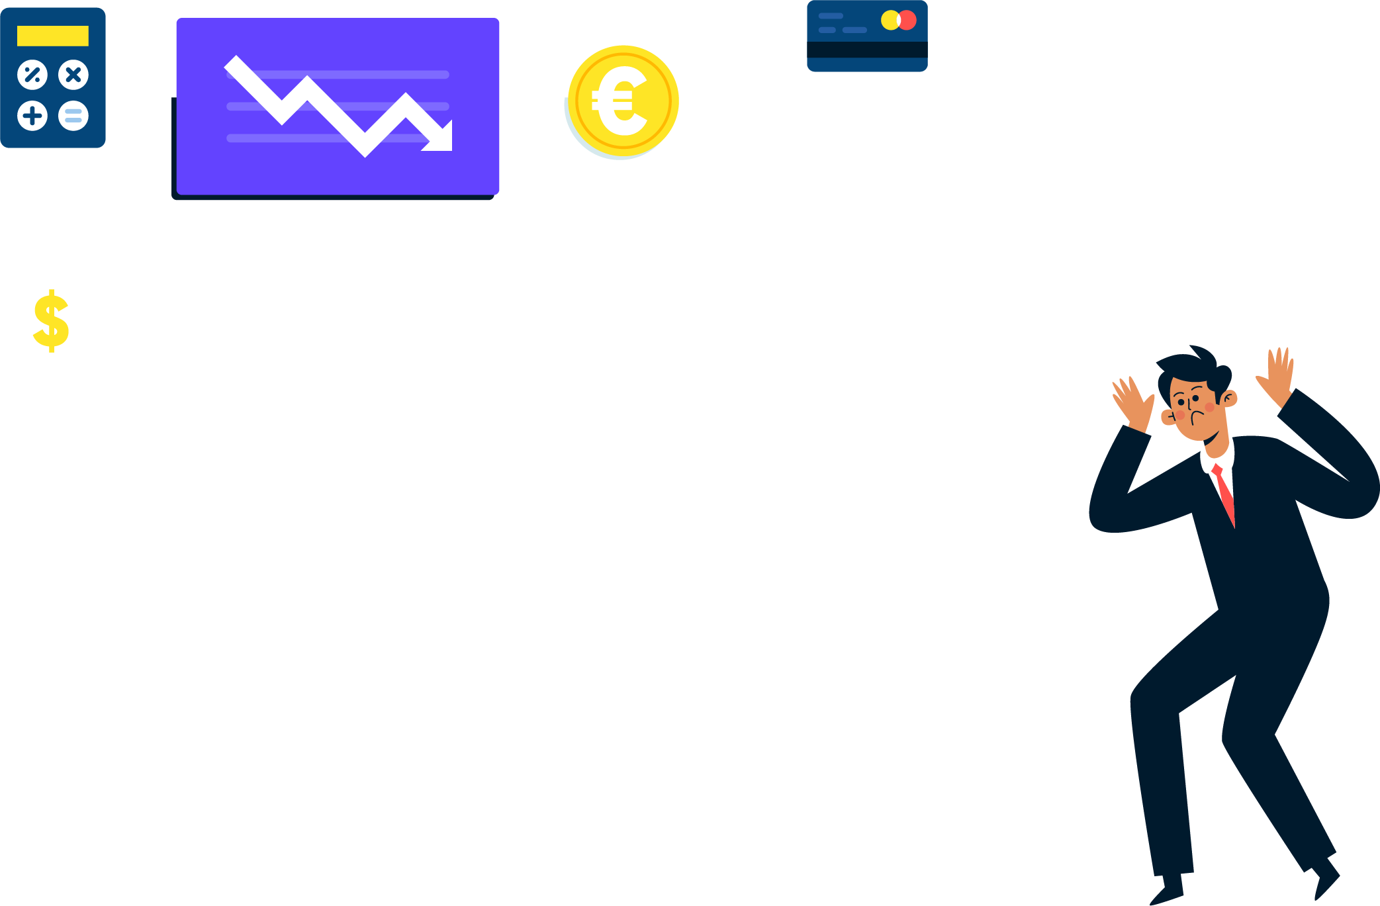

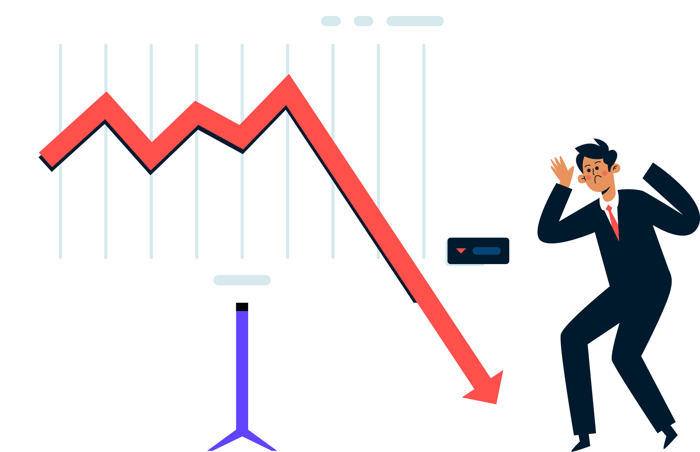



Asumsi kerugian per tahun
Resort Hotel
City Hotel
25%
30%
€ 484k
€ 1,500k
*Diambil dari kolom ADR
*Diambil dari kolom ADR
7 Miliar Rupiah
23 Miliar Rupiah

Slide 8


Solution>
SOLUSI?
Solusi?

Slide 9

Hotel booking
CANCELLATION RATE PREDICTION
Cancel Prediction

Slide 10


Target
Target
37%
Menurunkan cancellation rate
37%
Menurunkan Cancellation rate
20%
10%

Slide 11

Cancellation rate
Business Metrics
Revenue

Slide 12


Exploratory Data Analyst
Lead time
Pemesanan hotel dengan lead time lebih dari 7 bulan memiliki peluang pembatalan lebih besar (>50%)
Semakin lama Lead time semakin tinggi kemungkinan pemesanan dibatalkan

Slide 13
Exploratory Data Analyst
Parking Space & Cancelled Rate
100%
Pemesanan yang memerlukan tempat parkir tidak melakukan membatalkan pesanan
60%
40%

Slide 14
Exploratory Data Analyst
Cancellation rate by market segment
Berikut persentase tingkat pembatalan :
Groups 61% (tertinggi)
Aviation, Complementary, Corporate, Direct 18 - 22%
Travel Agent 34 - 36 %
61%
34%
36%

Slide 15
Exploratory Data Analyst
Guest location
56%
Pemesan turis lokal memiliki kemungkinan lebih tinggi untuk pembatalan pemesanan
23%

Slide 16
Exploratory Data Analyst
Cancellation rate for previously cancelled booking
92%
Pemesan yang sebelumnya pernah melakukan pembatalan pemesanan, memiliki kemungkinan lebih tinggi untuk membatalkan pesanan nya
34%

Slide 17

Data Cleansing and Pre Processing
Handle Missing Value
Handle Duplicated Value
Handle Outlier
Company 🡪 Drop
Agent 🡪 Ada ID = 1, tidak ada = 0
Country 🡪 Isi dengan nilai modus
Children 🡪 Hapus baris yang tidak memiliki value
Tidak ada duplicated
value
Mengubah outlier menjadi batas atas (High Limit)
Ganti nilai outlier dari feature yang memiliki nilai low limit dan high limit sama menjadi nilai terdekat

Slide 18

Feature Engineering
Feature Transformation
Normalized / Re-scaled
Categorical Encoding
Label encoding
One hot encoding

Slide 19

Feature Engineering
Feature Extraction
stays in weekend night
+
=
Total stays
stays in week night
Adults
+
Children
=
Total guest
+
Babies
Children
+
=
Kids
Babies
Guest Location = Value menjadi local and internasional
Meal = Undifined diubah jadi SC
Market Segment = Undifined diganti jadi nilai modus

Slide 20
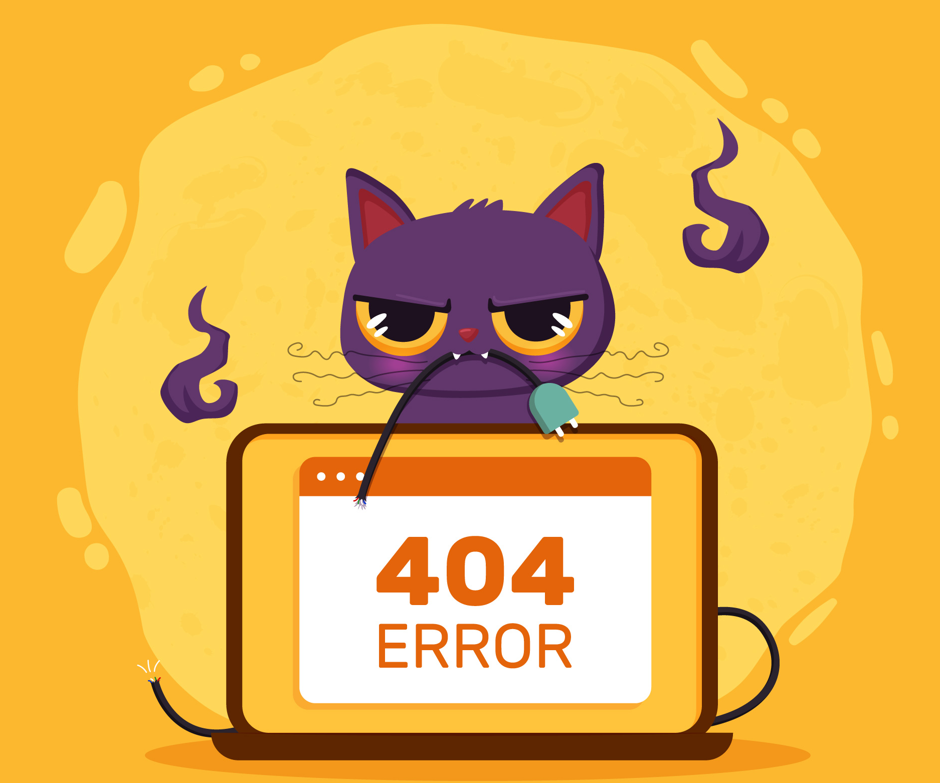
Feature Engineering
Feature Selection
Children
Name
Babies
Email
All
deleted
Stay in weekend nights
Phone Number
Credit card
Stay in week nights
ALL
DELETED!

Slide 21

119.390 rows
36 columns
BEFORE
119.386 rows
44 columns
AFTER

Slide 22

Modelling
Modelling Selection
Algoritma | Accuracy | Precision | Recall | F1 – Score | AUC
Logistic Regression | 80% | 81% | 62% | 70% | 88%
XGBoost | 84% | 83% | 71% | 77% | 92%
KNN | 84% | 79% | 76% | 78% | 90%
Adaboost | 82% | 81% | 68% | 74% | 90%
LightGBM | 82% | 91% | 58% | 71% | 90%
Random Forest | 89% | 88% | 81% | 84% | 95%
Decision Tree | 84% | 79% | 80% | 79% | 84%

Slide 23

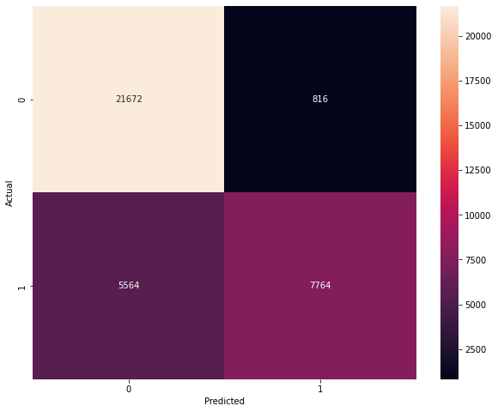
Confusion Matrics
Fokus pada predictive model yang paling bagus dalam menurunkan false positif
False Positif: Hasil prediksi customer melakukan cancellation tetapi kenyataanya customer tetap menginap

Slide 24
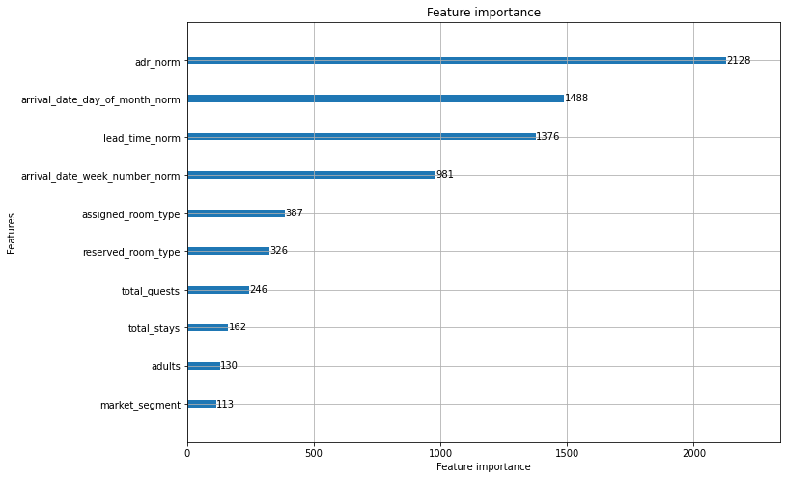
Feature importance
Feature yang paling berpengaruh terhadap cancelation adalah adr

Slide 25

Implementasi
Customer Predict Cancel?
No
Customer Booking and input data
Check via Model
Assign Room for Customer
Yes
Customer Cancel Confirmation (24h)?
Sent Notification to Customer
Yes
No
Room Available for Other Customer
Assign Room for Customer
*Free upgrade room jika customer tidak jadi melakukan cancel

Slide 26

Business recommendation
Non refund policy applied if lead time > 210 days
Check in Online
VIP Parking/Vallet
Phone reminder
Special offer for local customer
Hotel partnership
Customer loyalty point
Travel agent partnership

Slide 27

Simulation
Cancelation rate
Mengurangi potensi penurunan revenue sebesar
37%
25%
9%
20%
16%

Slide 28




THANKYOU

Slide 29
0
22488
0
11328
Precision Score = 33%
Naik 57%
Precision Score = 90%
Cancelation rate : 37%
Naik 57%
Cancelation rate : 16%

Slide 30
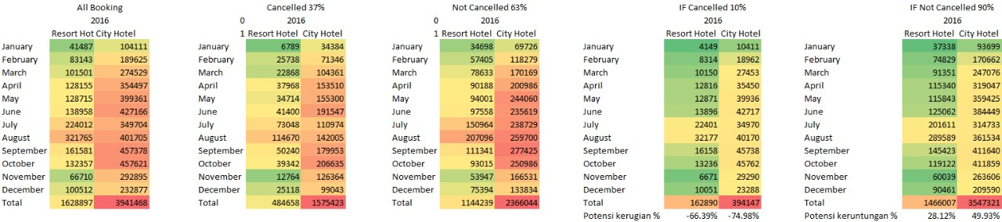

Slide 31
Exploratory Data Analyst
Repeated guest and cancellation rate
Non repeated guest lebih berkemungkinan membatalkan pesanan dibandingkan repeated guest
37%
14%

Slide 32
Simulation
Cancelation rate
Mengurangi potensi penurunan revenue sebesar
37%
30%
CITY HOTEL
xx%
16%
xx%

